Slide 1
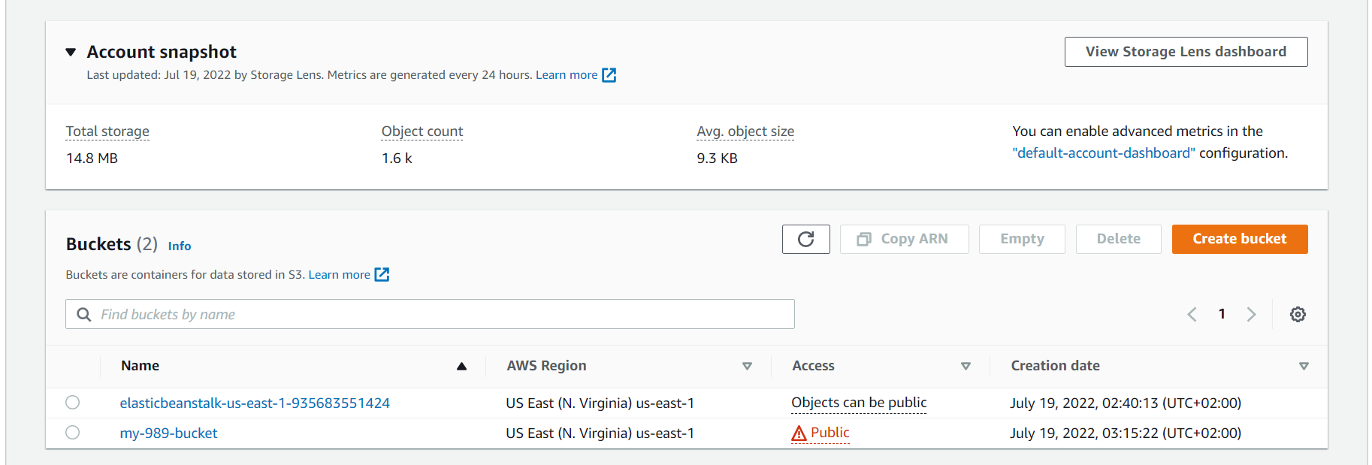
- My s3 bucket name in AWS (my-989-bucket)

Slide 2
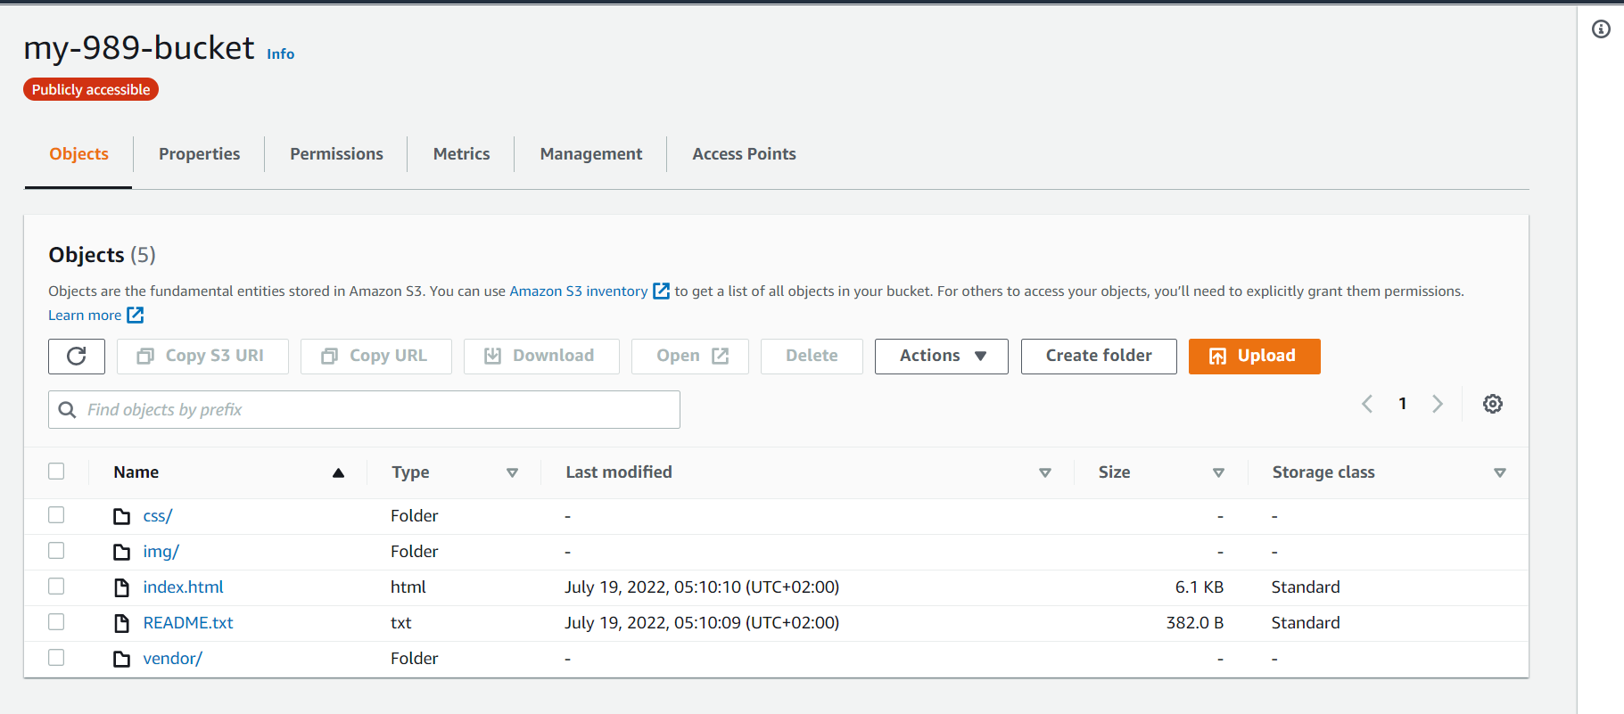
- All the website files uploaded in the s3 bucket

Slide 3
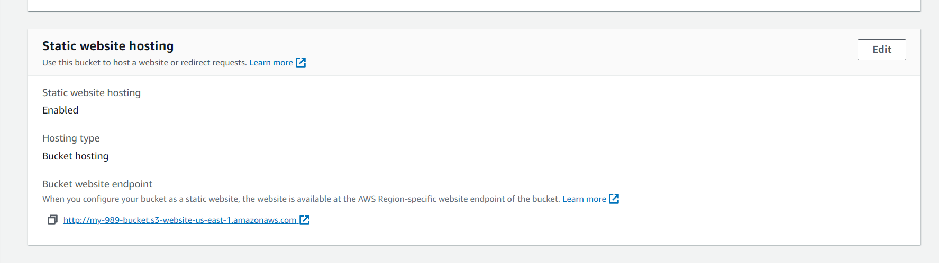
- The s3 bucket is configured to support static website hosting

Slide 4
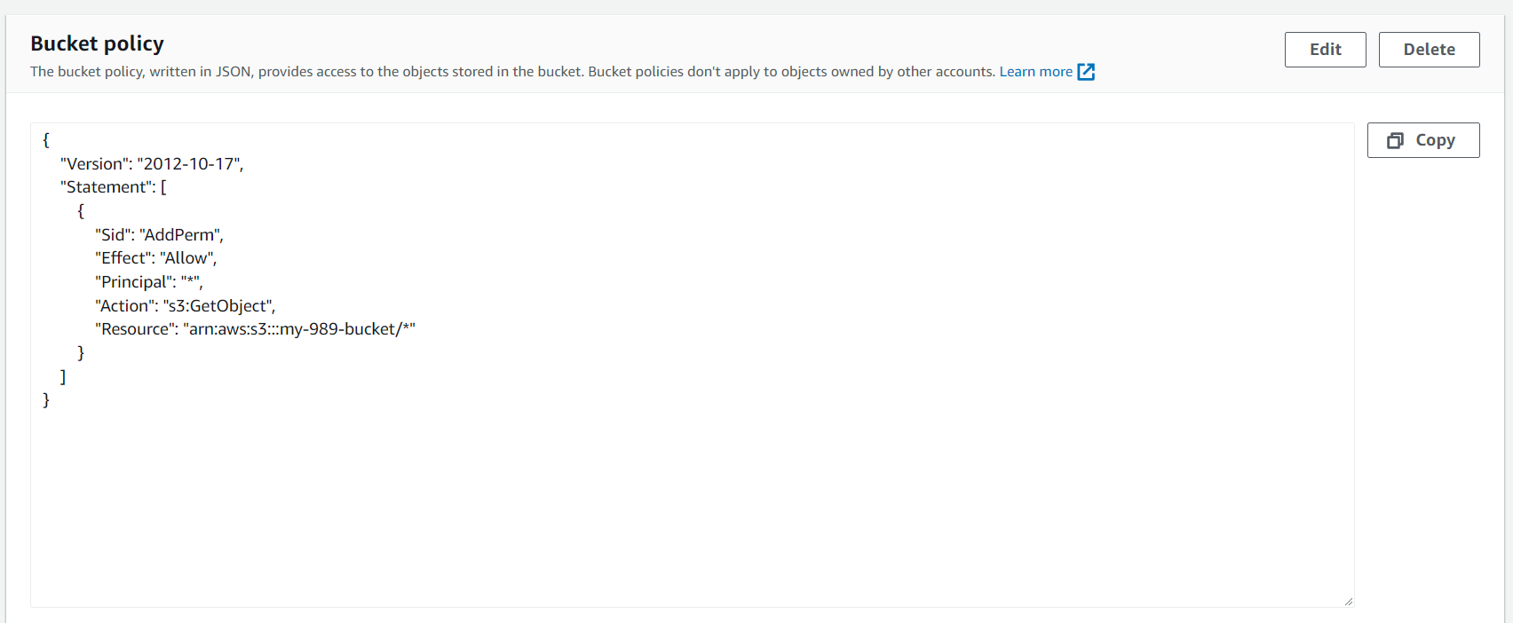
- bucket policy

Slide 5
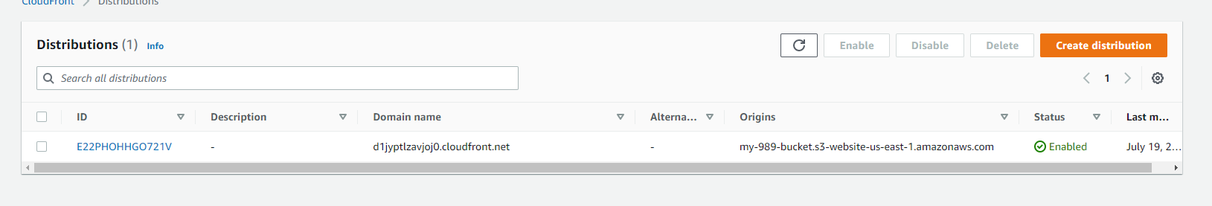
- Domain name for cloudfront

